Slide 1
BrOnline
Student: Ajaya Rai
Supervisor: Dr David Richerby

Slide 2
Overview
The project
Web application
Aim: tool that can be used by users to form groups that the users can utilise for individaul needs, e.g. self-improvement.
Why
Because men have been drawing energy from the “Brotherhood”; especially during dire time like wars. So, it can be used in modern days where people can flourish.

Slide 3
Objective and achievement before Week 14
Challenge Week Plan
Complete all the logic for MVP, and then after that focus on the design
Features included:
Registration
Sign-in
Add/Remove groups
Add/Remove members to the group
Profile Page
Leader
Add/Remove members to the group
Search page, which include the people and the group:
User can click on the people to view their profile
User can click on the group to view its details
Logout
Things completed:
Registration
Sign-in [DONE]
Add/Remove groups
Add/Remove members to the group

Slide 4
Objective and achievement after Week 18
Plan:
Chat system
Search page:
Search People
Search group
Leader:
Group creator == leader. Leader’s power:
Change the bio
Add/Remove members
Completed:
Chat system
Search page:
Search People
Search group

Slide 5
Major parts
Plan change: from features & designing to features only
Basic architecture = from frontend to backend to firebase, then optionally to frontend. E.g. Bio
Multi page to page without refresh
DB where two things are stored, e.g. user’s groups and group members
Emulator
URL for adding members

Slide 6
Survey
Participant 1
Name: Marvin Cudjoe
Email: mc17009@essex.ac.uk
Course: BSc Computer Science
Rating: 6.4/10
Participant 2
Name: Tianyu
Email: tt92reds@gmail.com
Course: BSc Computer Science
Rating: 7/10
Suggested improvements

Slide 7
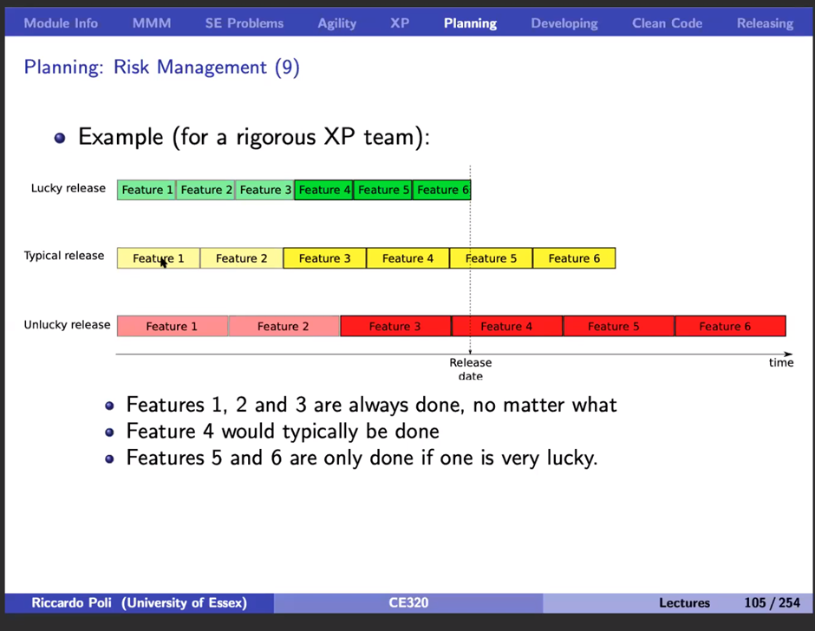
Conclusion
Overall, give myself 7/10
Evolution of the technology
Weakness = estimating work done
Helped to have clarity on what I wanted to build in the future. E.g.
Set regular session, but allow random

